Slide 1
SWFDP- SEVERE WEATHER FORECASTING
DEMONSTRATION PROJECT- Event -Southern Africa
RTC Pretoria 16-20 November 2015
DESCRIPTION OF PUBLIC WEATHER
AND WARNING SERVICES IN MADAGASCAR
with
Mrs. Balsama RABETOKOTANY
Ingénieur Principal de la Météorologie-Planificateur Principal de Développement
Directeur des Exploitations Météorologiques (et Hydrologiques)
Direction Générale de la Météorologie
SMHN -- MADAGASCAR

Slide 2
STRUCTURE OF WARNING ADVICE AND ALERT SYSTEM
AUTORITES
-Présidence
-Primature/CNGRC
-MTTM
-Autres ministères
Notes:
1-Describe RELATIONS between forecasters and disaster management in your country briefly
- Staff meeting (within DGM and within MTTM); weekly
-During the event: a committee of interveners (CRIC) organize a meeting in BNGRC office and the head of the forecasting service Me or Rivo have served as an interface to explain the present and future situation in real time to them
-With the government: the PM with CPGU through the CNGRC gather all the ministries in charge of the response measures and the PR or me do the same presentation of the event (AT ANYTIME THEY NEED)

Slide 3
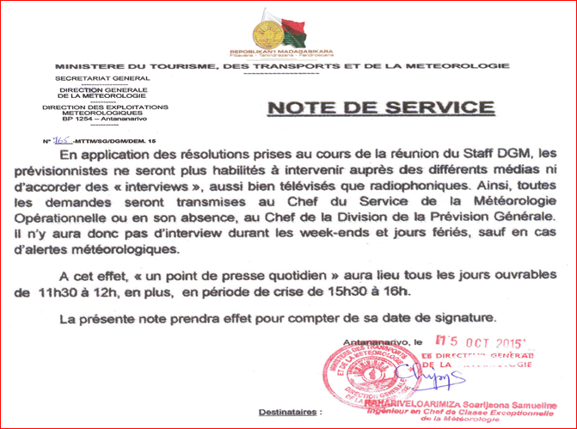
SPECIAL SCHEDULE FOR MEDIA SKILL
UPON THE FORECASTERS’ AREA
Notes:
2-Describe DISSEMINATION METHODS used for warnings, including those for reaching the rural and remote areas
WARNING Dissemination:
radio alerts warning can be preceded by a distinctive siren or melody,
television can utilize background footage of typical conditions,
and usually MEDIA add maps of where to proceed emergency measures or preparadness and response actions

Slide 4
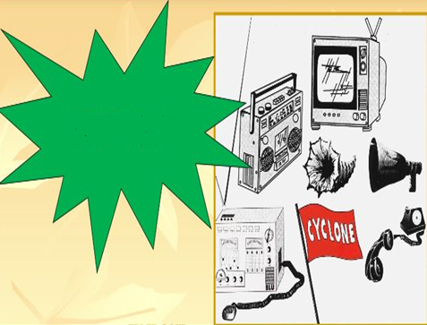
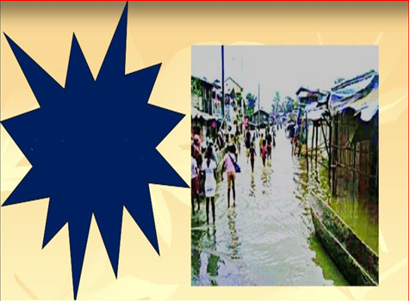
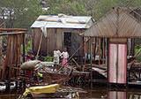
< 5-2days
BE AWARE
< 48-24H
BEFORE IMPACT
WARNING AND ALERTING STIMULI
< 12H
BEFORE IMPACT
24-12H
Post-IMPACT
Notes:
3-Give a brief highlight of the CHALLENGES IN WORKING with the disaster management authorities in your country, as well as with the media
STRATEGIE:To be of maximum effect, warning must alert the community at risk, clearly communicate the physical nature, potential danger and urgency of the threat, and recommend avoidance/preparedness measures
Such warning and alerting stimuli may take many audio-visual forms and actions and it has made improvement during the last few years, by using Meteo Factory System
-Vigilance “Fortes Pluies”-> severe heavy rains
-Provided regionnally in TANA, Vigilance Inondation related to severe rains with inondation threat
Vigilance “Marine” related to sea surging threat
-Vigilance”Cyclone” related to cyclone event

Slide 5
CYCLONE SEASON SUMMARY 2014 - 2015
Total count of fourteen tropical storms,
Including two into very intense tropical cyclones
Cumulating 56 days of disturbed activity.
Abnormal meteorological situation that prevailed over the Mozambical channel, especially in January 2015, a month that cumulated by far the strongest disturbed activity (VITC BANSI and EUNICE) in the OI bassin.
Few systems came together: FTT ADJALI / DT N°02, CTI KATE / CTTI BANSI / FTT CHEDZA, TTM DIAMONDRA / CTTI EUNICE, DT N°11 / TTM HALIBA et enfin CT JOALANE / CTI IKOLA.
Particular configuration of the trajectories was favourable for Madagascar, which has been a matter of huge and deadly floods and landslides impacts of storms and heavy flash rain (FTT CHEDZA / FTT FUNDI / DT N°11).
Notes:
4-How is FEEDBACK PROVIDED from the disaster management to the forecasters on their level of satisfaction with the services of the NMS?
- This past Cyclone season (2014-2015), the degree of confidence in the capacity of community, social and funding response interveners and also officials to martial resources for implementing preparedness measures is specifically significant
They approve positively in public our forecasting as efficient
A Communication Service that I have initiated has gona be operational (four years ago created):
- The process to collect user feedback and performance metrics to continuously evaluate and improve upon products and services is going on, may be as a follow up of this training WE MAY really improve and enhance the collaboration with media which had been initiated on the beginning of this month

Slide 6
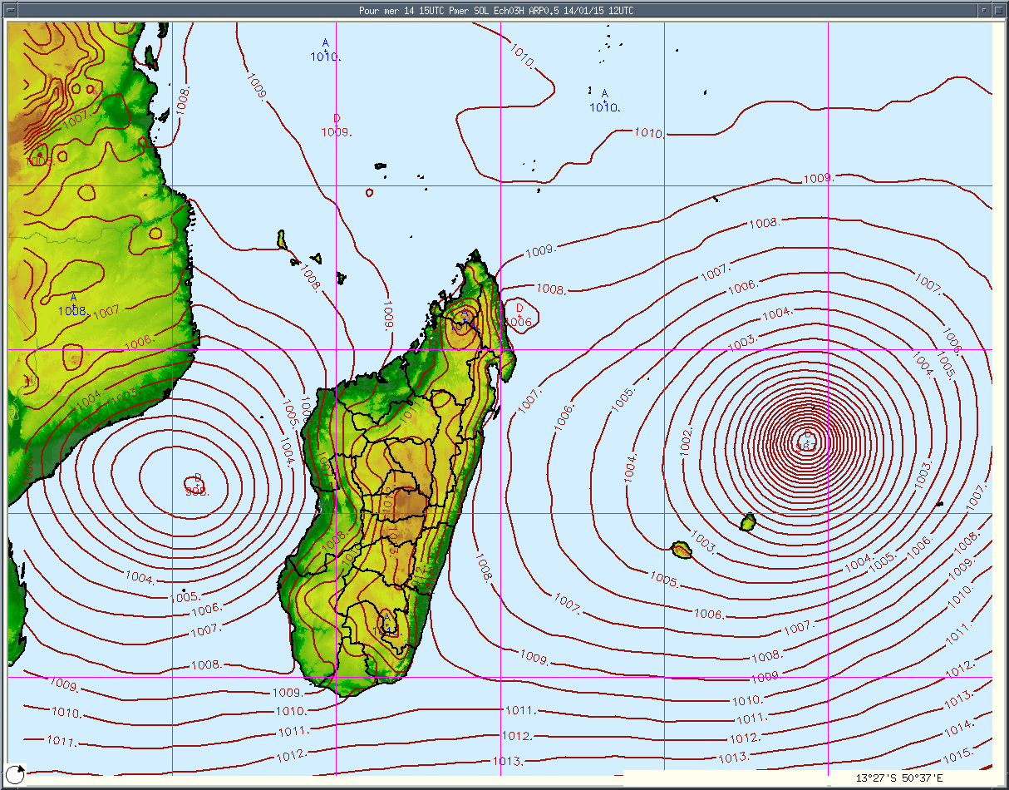
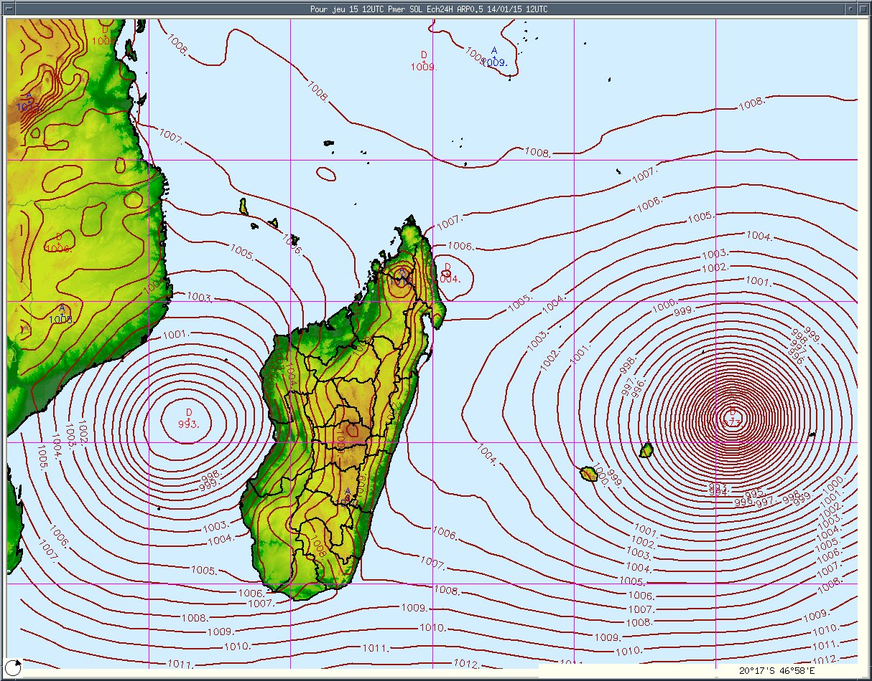
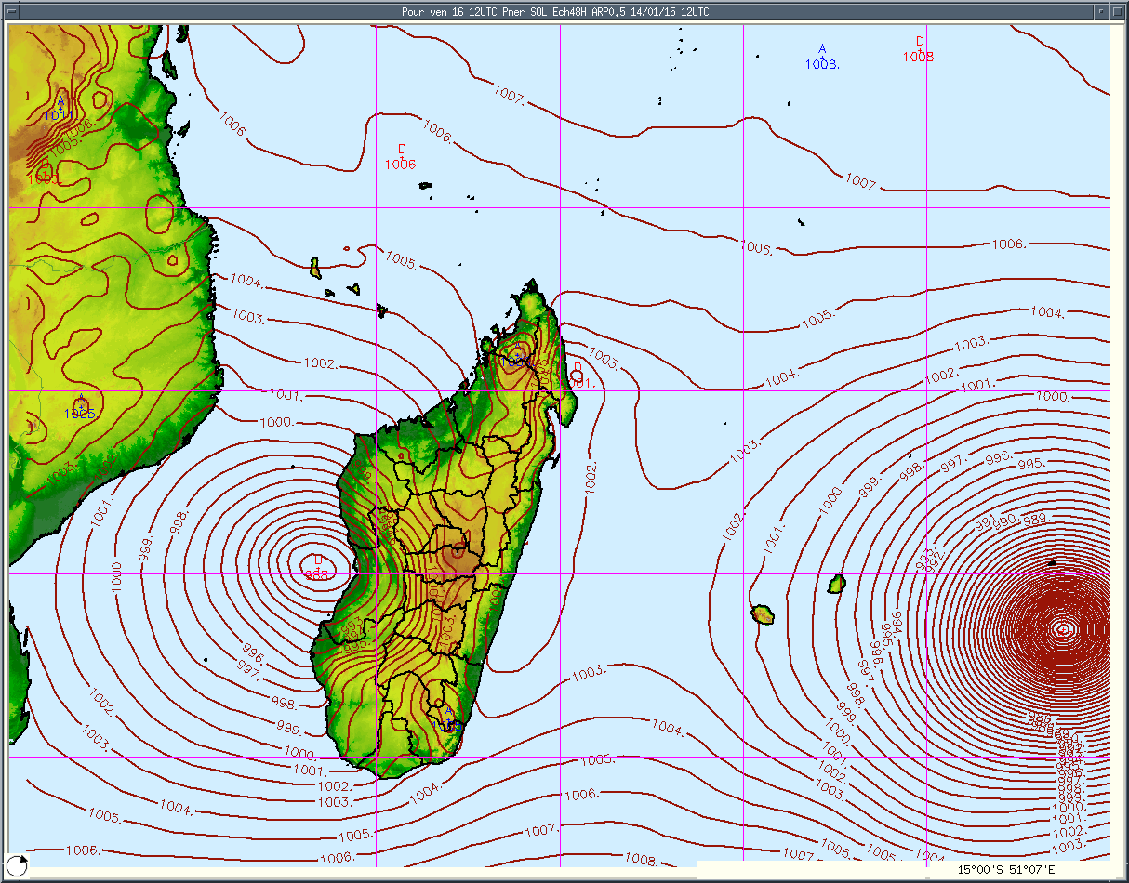
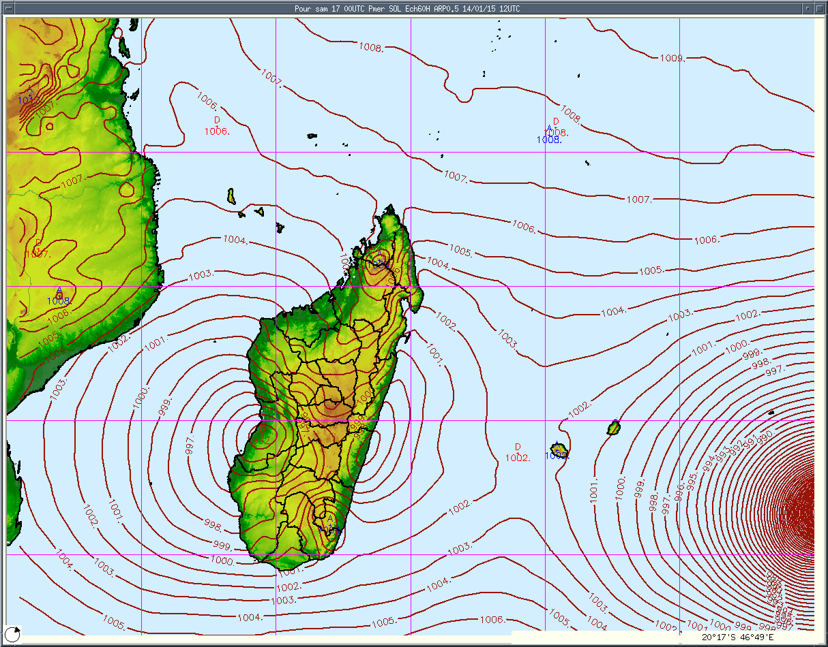
Evolution of BANSI and TP N°06 on 18th Jan15
Source: DGM/MTTM
Notes:
METHOD AND WAYS OF WORKING TOGETHER: Predictions are given on the basis of persistence and current surface synoptic conditions
A situation of Rapid Intensification (RI) can become critical when it occurs close to a populated area with the landfall happening soon after, since the lead time may then become too short for the issue of a proper warning to the public (that case occured in Antananarivo during the last amazing season)

Slide 7
RAIN FORECAST IN DIFFERENT IMPACTED
WELL KNOWN SITES
Antananarivo
Toamasina
Morondava
Farafangana
Toliara
Taolagnaro
Source: DGM/MTTM /ECMWF

Slide 8
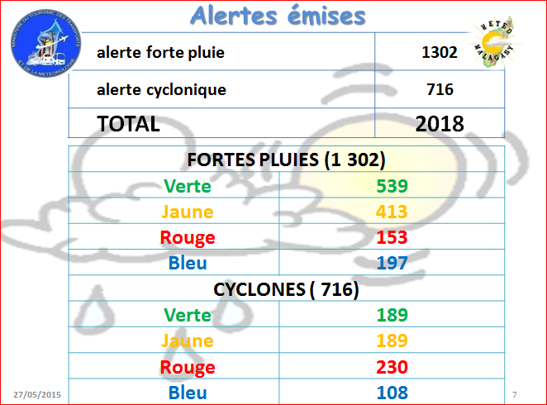
Preparedness and response exercises can reduce the chances for the advice and alert system to fail
3 days workshop in July 2015
LEARNT LESSONS
Présenté par: Balsama A. RABETOKOTANY
Directeur Général de la Météorologie pi
Directeur des Exploitations Météorologiques
Notes:
5-How is feedback obtained from the public on their satisfaction with your services? Please bring along any SAMPLE OF questionnaire/public SURVEY you have conducted
- SYSTEM REVIEW PHASE or SURVEY
At the end of TC season, a review is conducted of the total performance of the warning and response system (in June/July)
Usually, in annual review conferences/Workshops cover internal procedures as well as external liaison with counter-disaster authorities (BNGRC and CPGU) and ONG or funders
Each new TC season brings unique experience which may need to be incorporated into new warning procedures and or preparedness contingency plans
Major innovations involving the community may need to be tested for their feasibility before final adoption
In cases when a TC has not impacted as usual and there has been a substantial breakdown in the warning/response process, it should be taken for an appraisal to the system
Lessons for each season are needed to future hazard event regards
- GATHERING RELEVANT OBSERVATIONAL AND HAZARD-RELATED DATA and discuss warning-response performance

Slide 9
Increase of collaborating process is growing up
-The service head has retired (Vincent)
- PREVI chef before Rivo moved to ASECNA
-Young new forecasters not yet enough trained
Notes:
EFFECTIVE WARNING request close collaboration with them: through development of strong partnerships with all levels of decision-makers involved in disaster prevention and mitigation
PROBLEMS
the “Pre-warning” of the dangerous event is not enough
Increasing the detail and urgency of the information
The community is expected to make immediate arrangements for its safety and security, and businesses and industry assistance
FORCASTING HUMAN RESSOURCES CAPACITIES IMPROVEMENT
- Before ending regarding the last question to Madagascar presentation, we are suggesting toward SWFDP, this running project, somehow I stress on how to carry on FRENCH on site training to solve the problem of lack of forecasting staff (capacities emprovement and increasing in number)

Slide 10
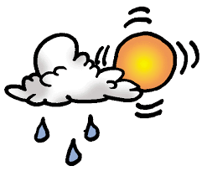
PERSPECTIVES
PRIORITY: 7 AWS (stations automatiques d’observation) Installation (improving real time data base)
Extension of flash flood warning regionally on East and South (like on Fiherenana in South-East)
Action to follow up : Improving the information scaling and details ( recently created Vigilance marine for coastal threat)
Proceed on longer term program of mitigation to minimize losses which is too difficult to be avoid by short-term preparedness measures
Notes:
SHARING OF OUR LACK TO CNGRC: staff, capacities, deployment of resources…
-RANDRIANARISON Rivo Herilala
The head of the forecasting Division
RANDRIAMANANTENA Roger
Forecaster (Master degree only this year)
RAHARIMALALA Huguette Oméga
Forecaster (Master degree only this year)
ANDRIAMPARISON Hubert
Forecaster (in study final stage as a master degree)
RADAFY Julien Victor
Forecaster (Assistant ) with long term experience
NOMENJANAHARY Mamy Andriamirado (Mirado)
Prévisionniste Stagiaire
SOLOHARY Tody
Prévisionniste Stagiaire

Slide 11
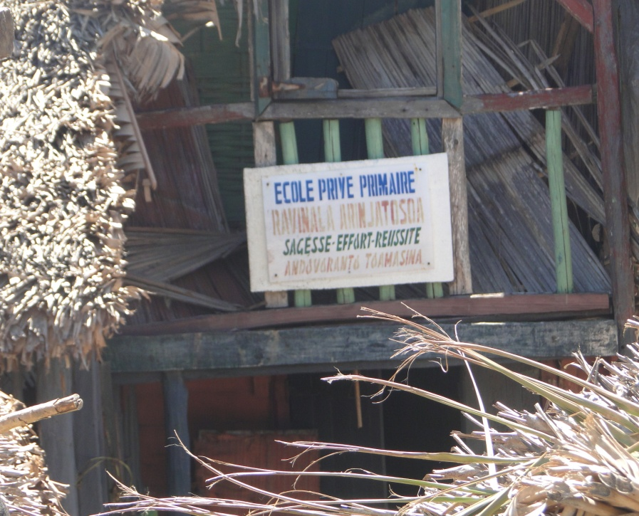
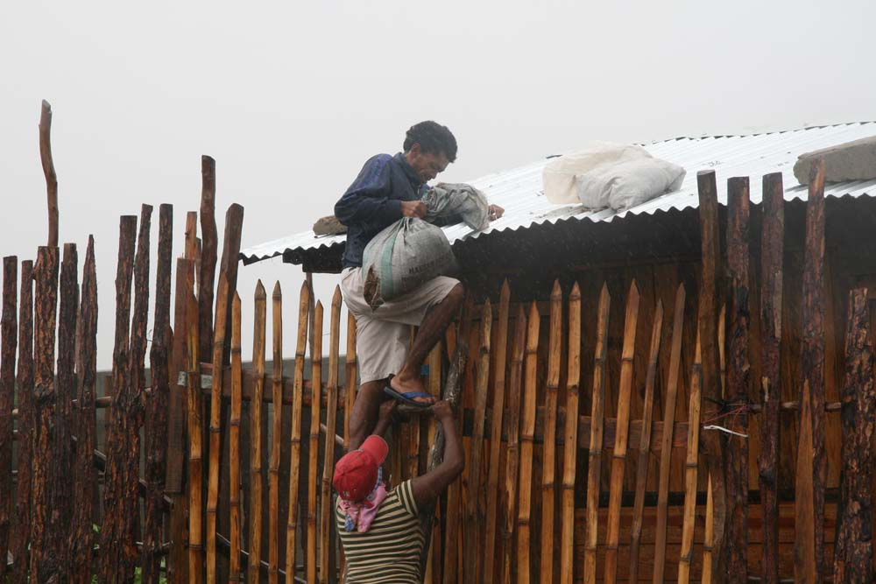
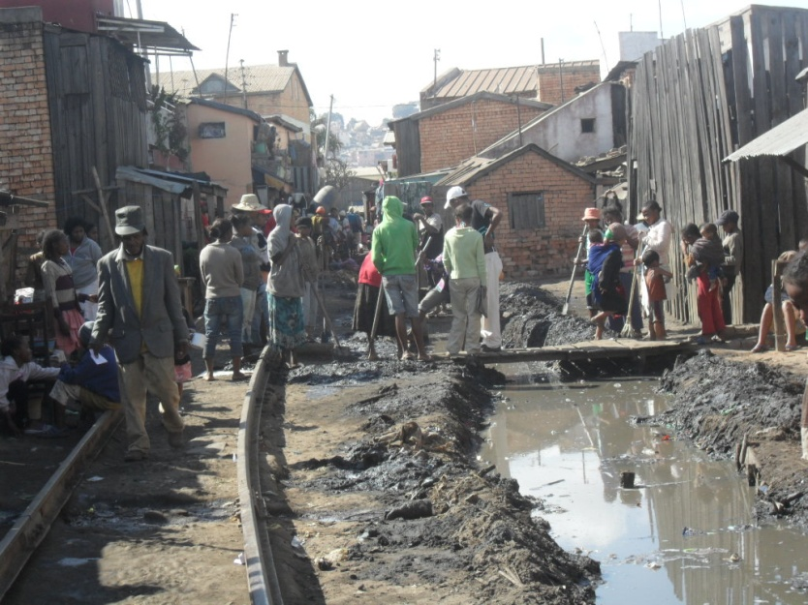
TEXTO- SITUATION AT 10 A.M. FTT ADJALI 991 HPA À 2100KM NE SAMBAVA , DÉPLACEMENT SSE 15KM/H AVEC RAFALES 110KM/H

Slide 12
www.transport.gov.mg
www.meteomadagascar.mg
SMHN -- MADAGASCAR

